Slide 1
bwh.
BRUINS WITH HOLDINGS
BRUINS WITH HOLDINGS
WITH HOLDINGS. BRUINS WI
BRUINS WITH HOLDINGS. BRUI
LDINGS. BRUINS WITH HOLDINGS.
CS35L Fall 2022
Kaylee Mei Chao Jessica Lin Annie Xiang Claire Zhang
NGS. BRUINS WITH HOLDINGS. BRU
HOLDINGS. BRUINS WITH HO
BRUINS WITH HOLDINGS
BRUINS WITH HOLDINGS

Slide 2
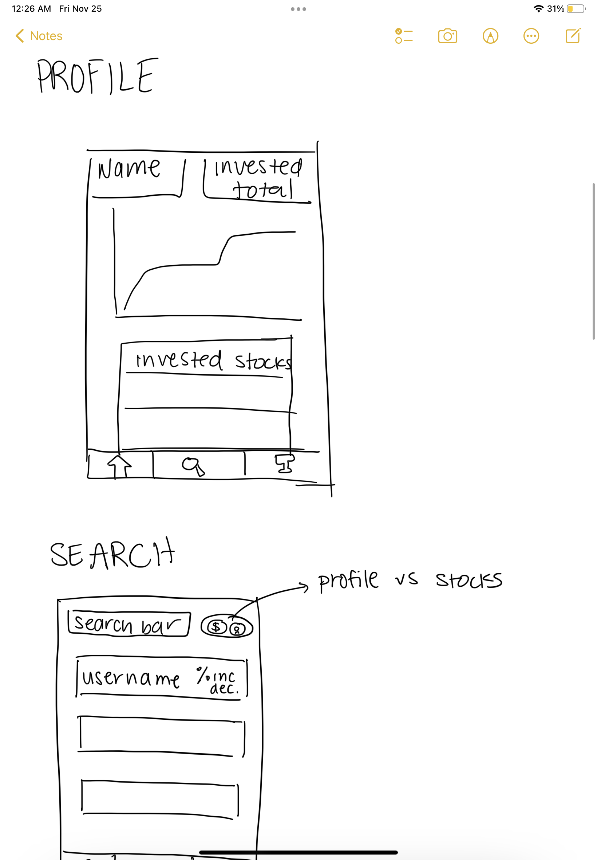
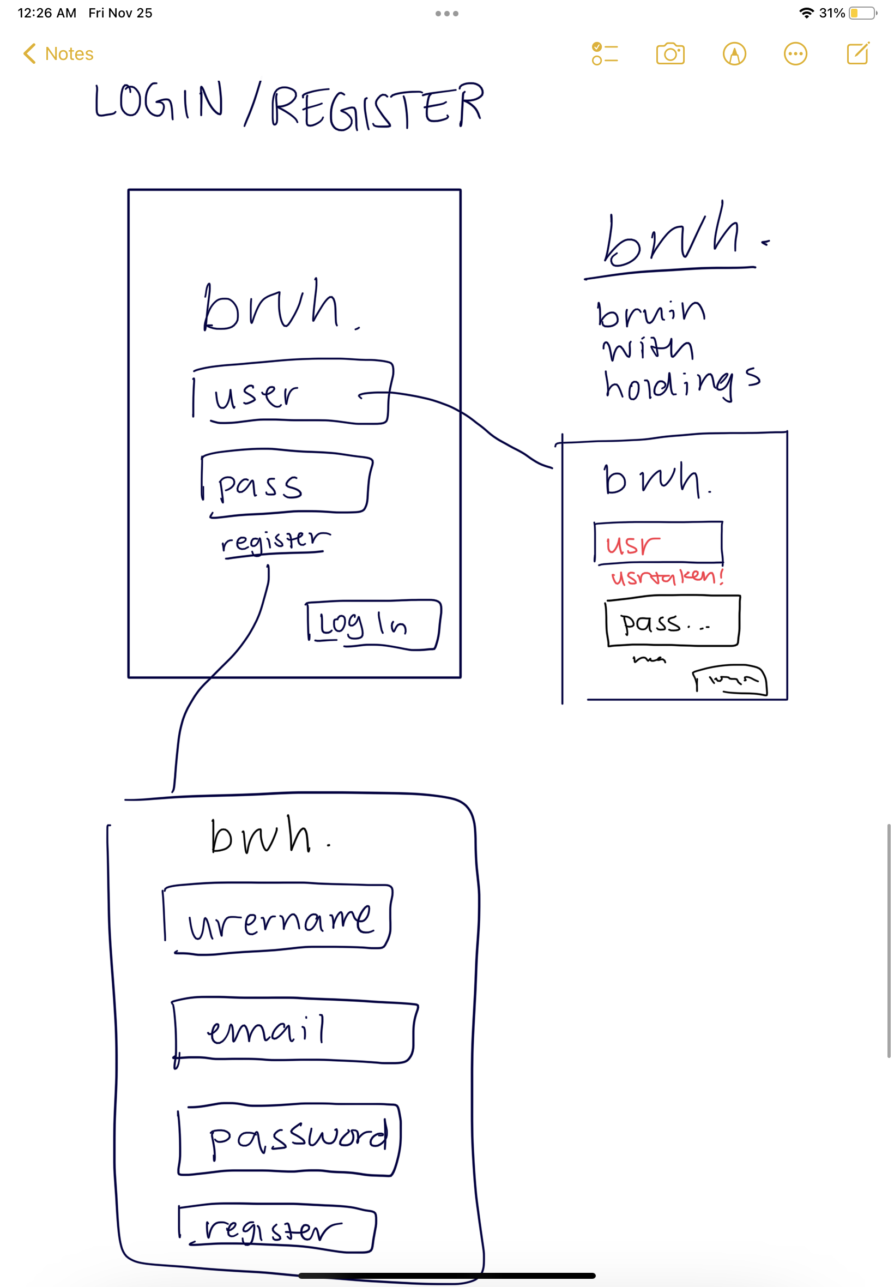
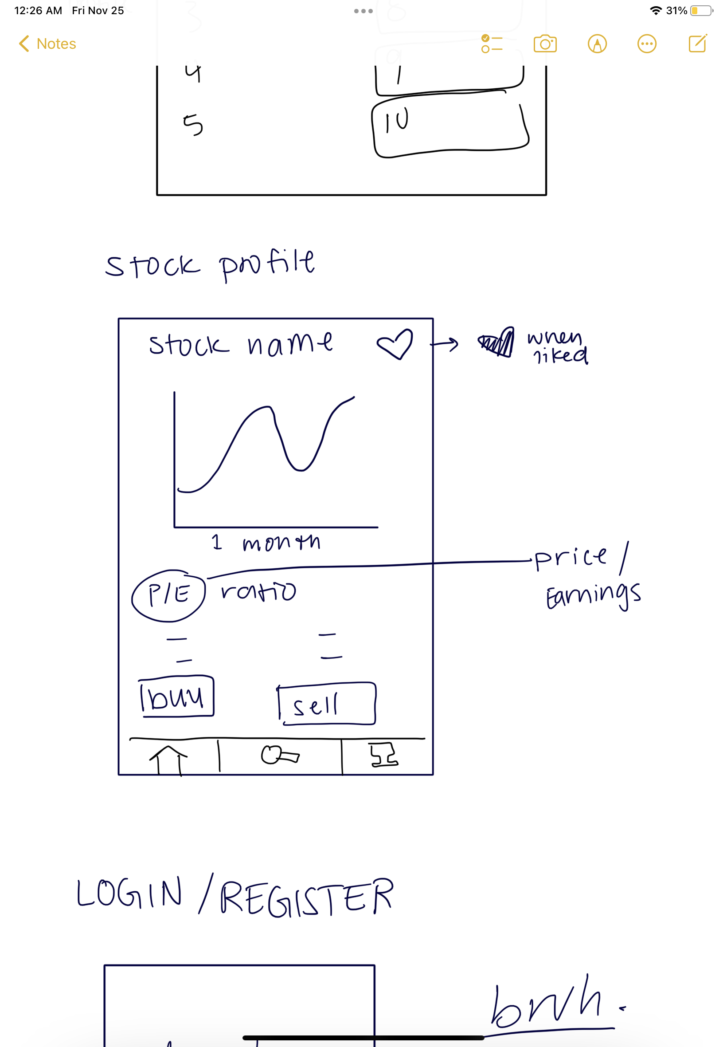
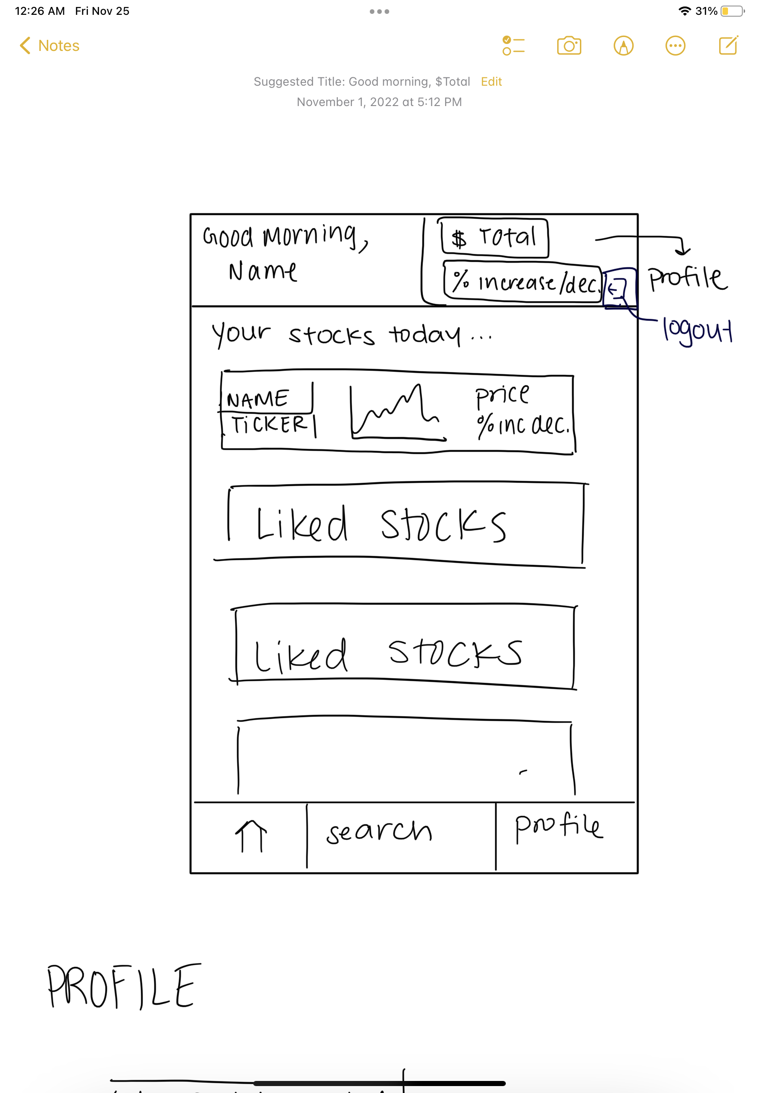
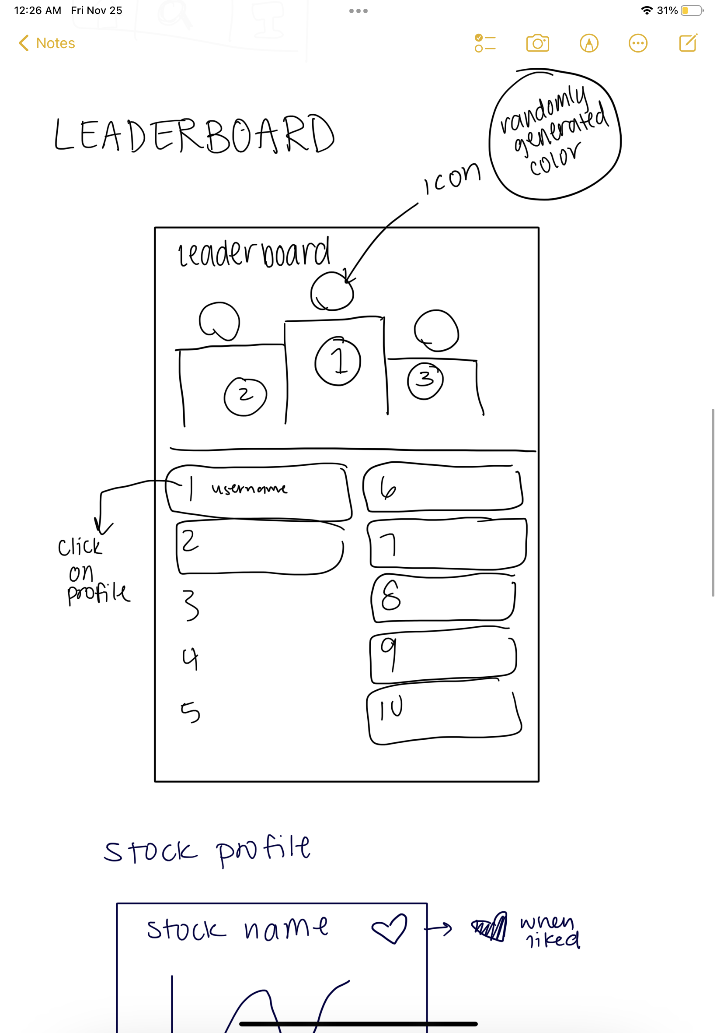
CONCEPT
🍐 Stock Simulation App
🍐 Virtual Currency
🍐 Build a stock portfolio
🍐 Compete with others
🍐 Visit other profiles

Slide 3
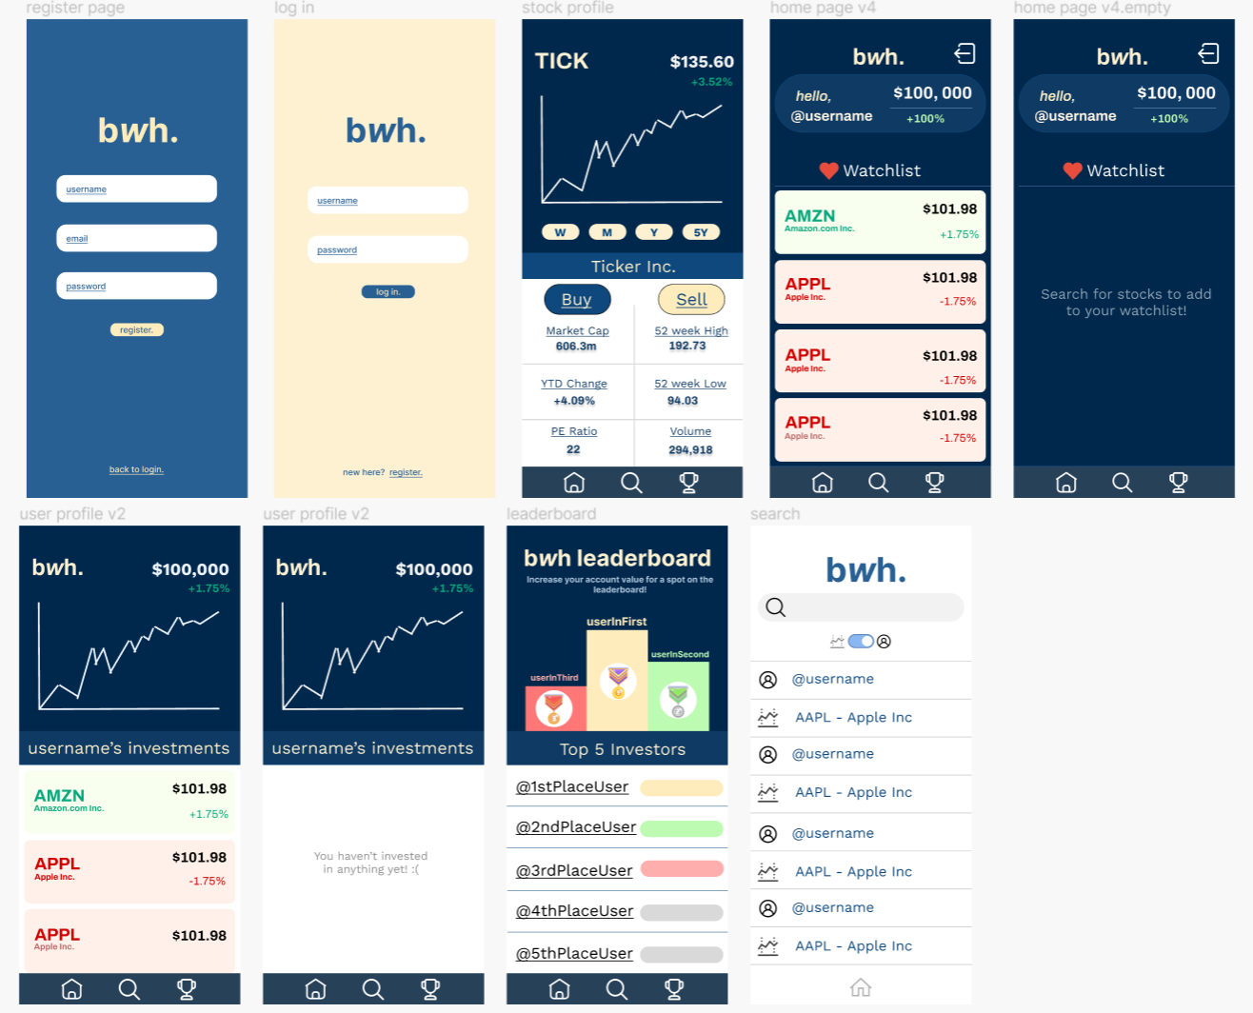
DESIGN
🍋 Figma
🍋 UCLA Colors
🍋 BRUH → bwh.

Slide 4
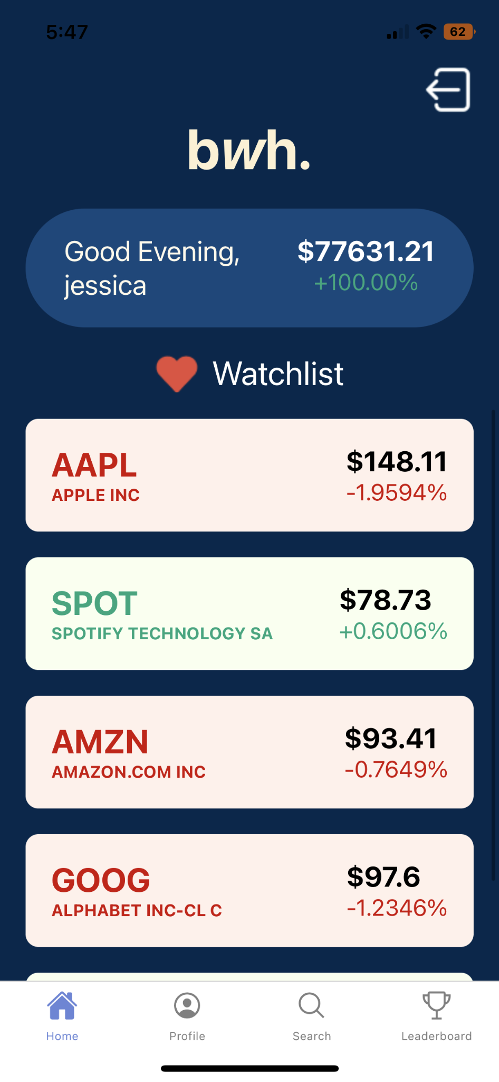
HOMEPAGE
🍋 Account Overview
🍋 Watchlist
🍋 Stock Cards
🍋 Navigation Bar
🍋 Logout Button

Slide 5
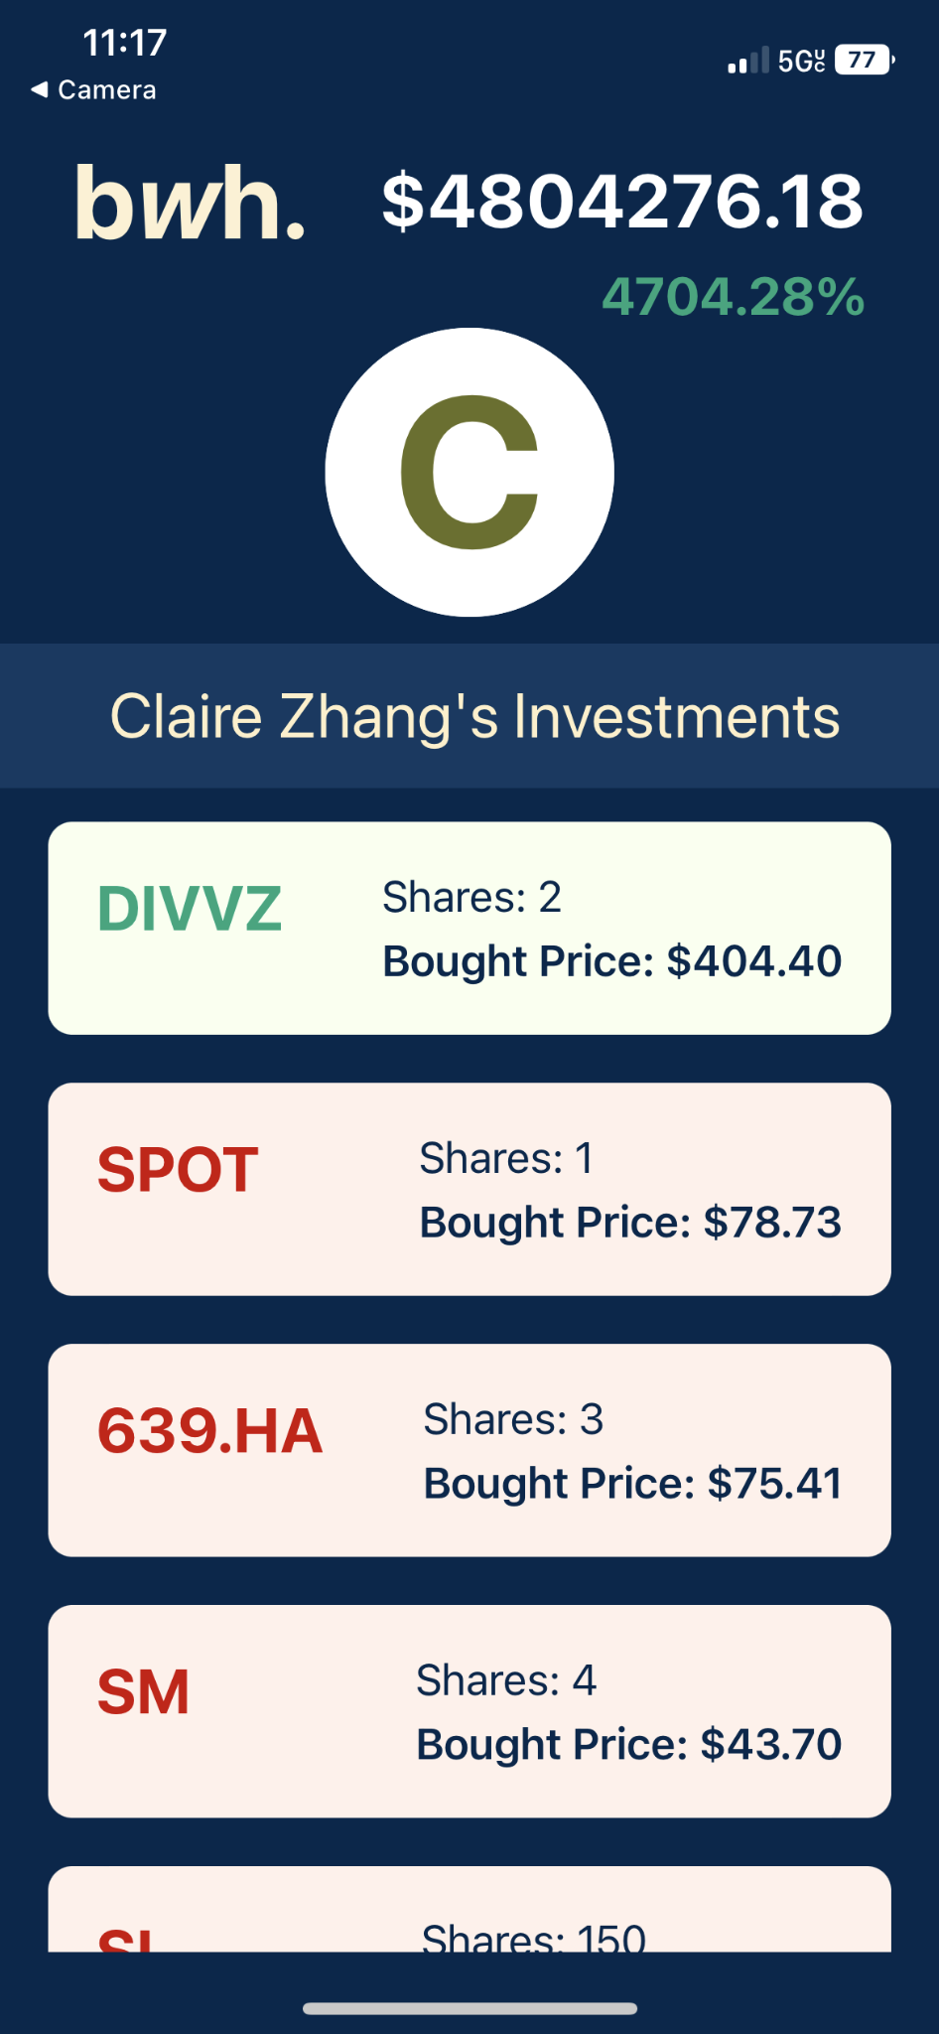
USER PROFILES
🍐 User Investments
🍐 Account Value
🍐 Current Percentage Inc/Dec.
🍐 Buy Values + Total Stocks Purchased

Slide 6
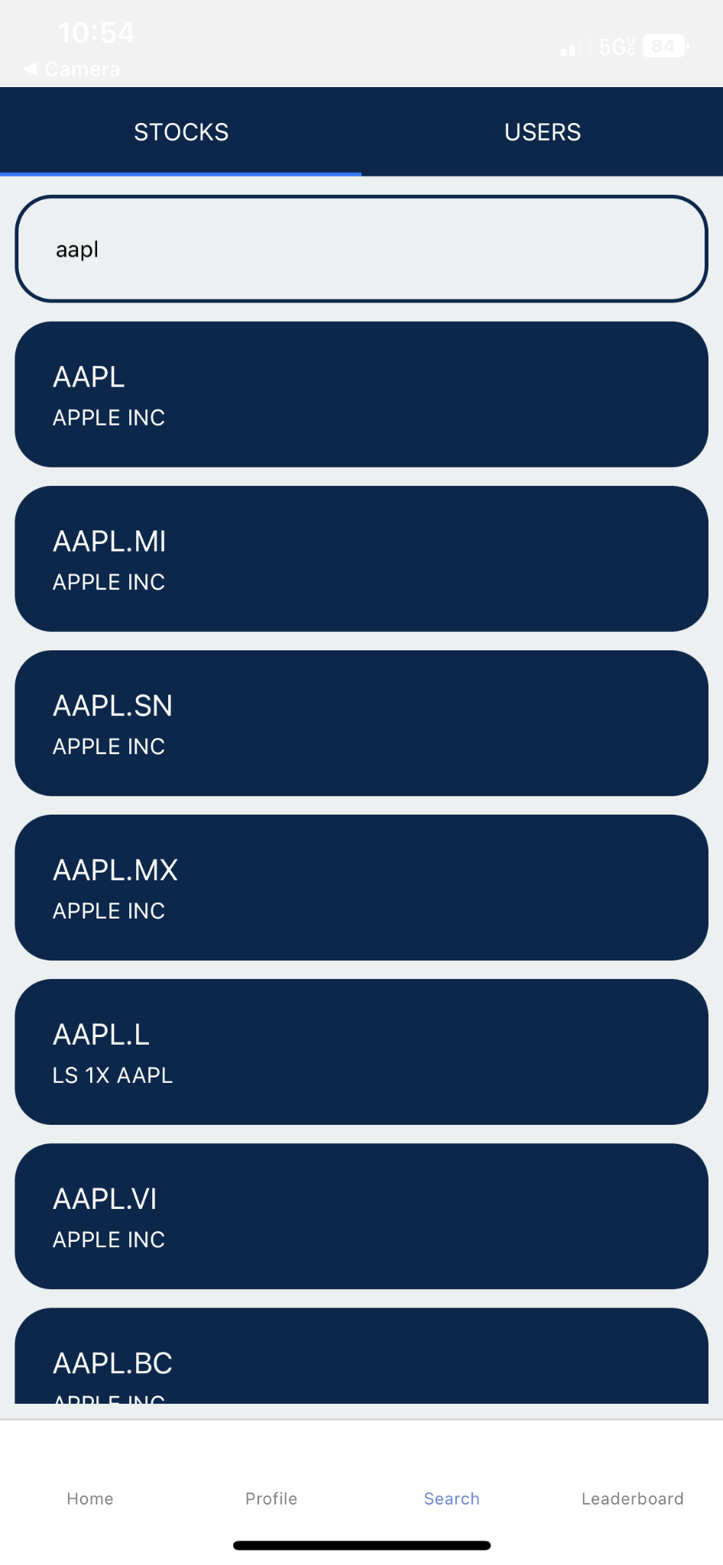
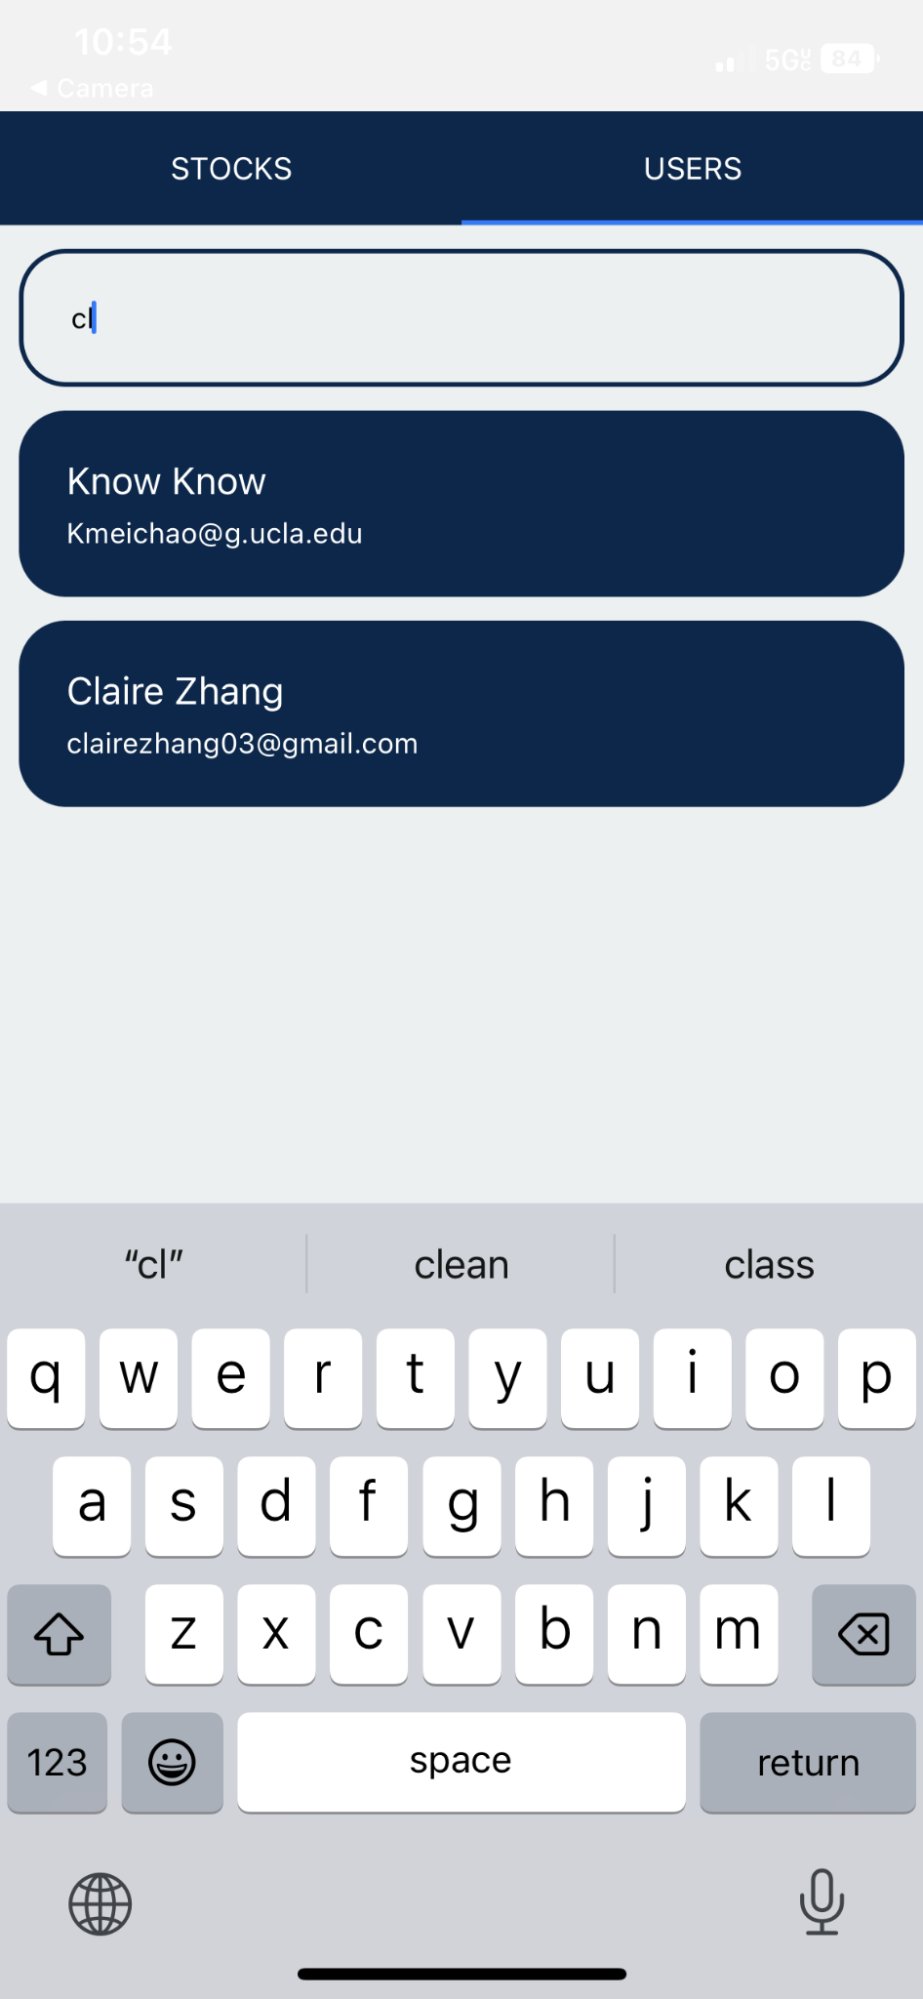

SEARCH BAR
🍋 Search for users or stocks
🍋 Stocks use Finnhub API,
Users stores user collection
from Firebase
🍋 Click to view profiles
🍋 Data from Finnhub and
Firebase

Slide 7
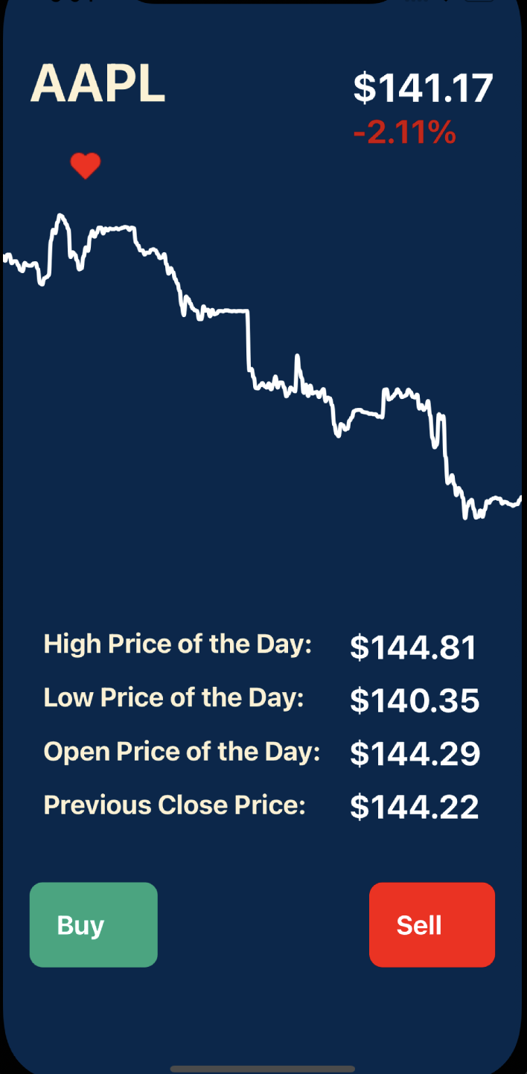
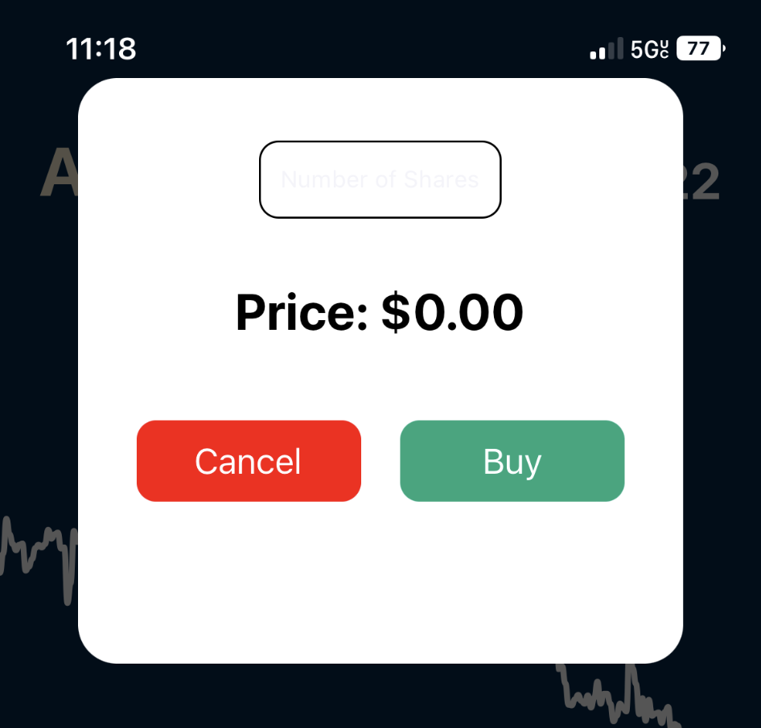
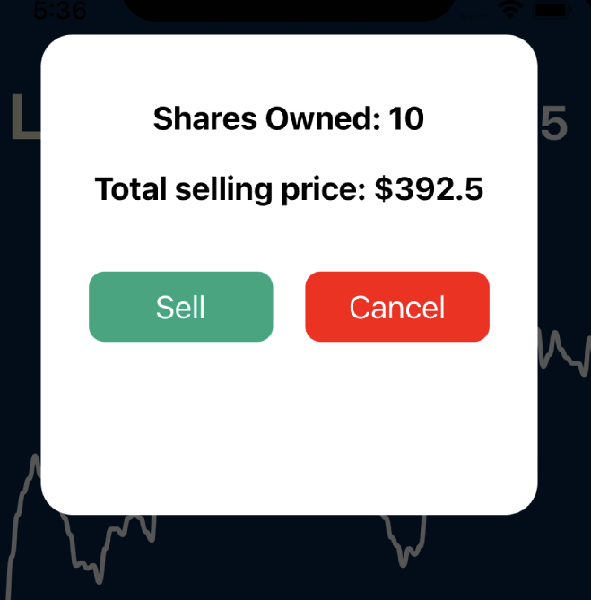
STOCK PROFILE
🍐 Data from FinnHub
🍐 Buy/Sell Stocks
🍐 View Stock Data
🍐 Liking stocks to add to watchlist

Slide 8
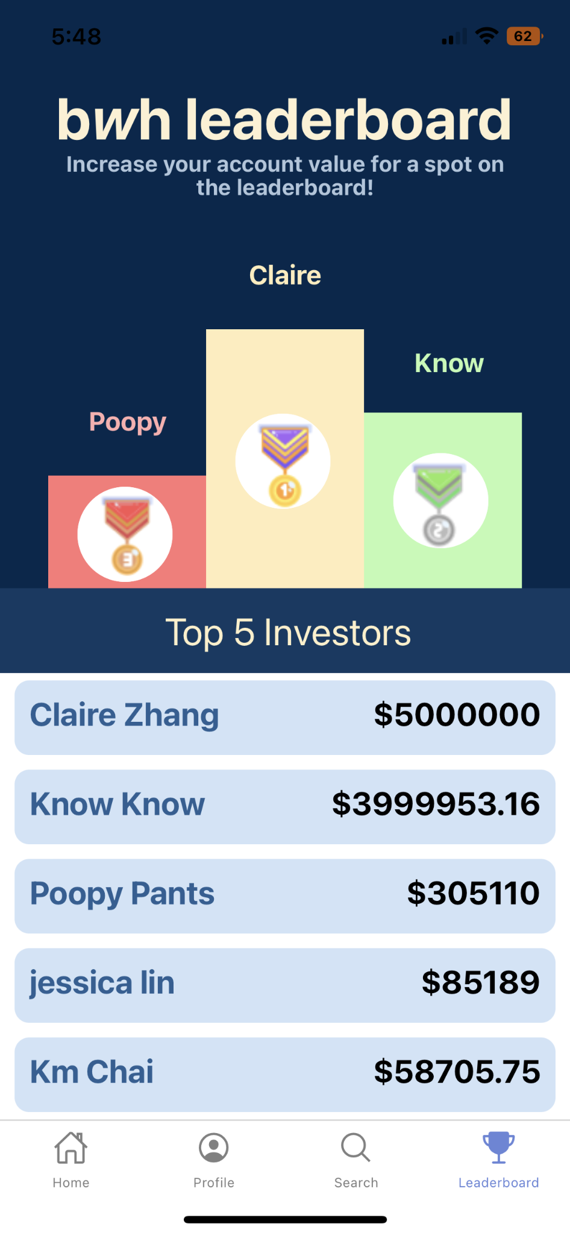
LEADERBOARD
🍋 Podium
🍋 Top 5 Investors
🍋 Displays Account Value
🍋 Viewing Profiles

Slide 9

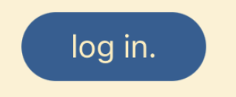
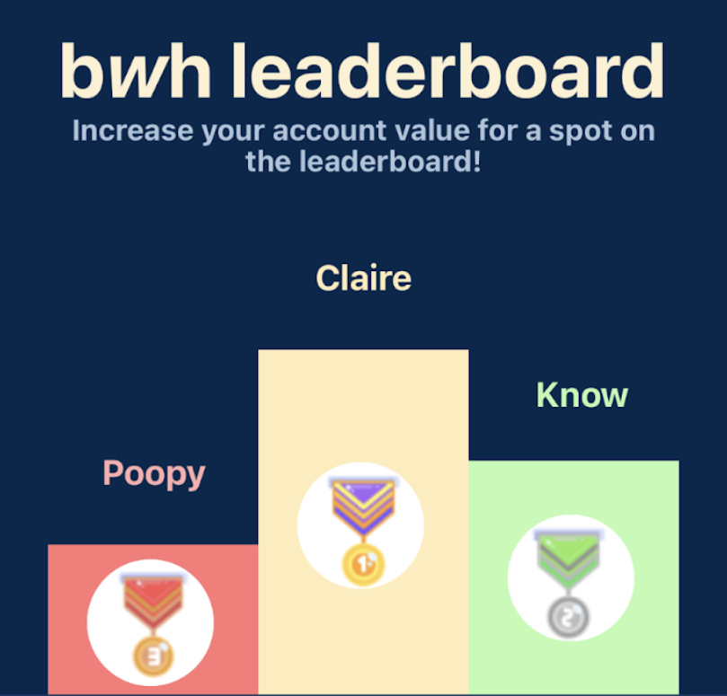
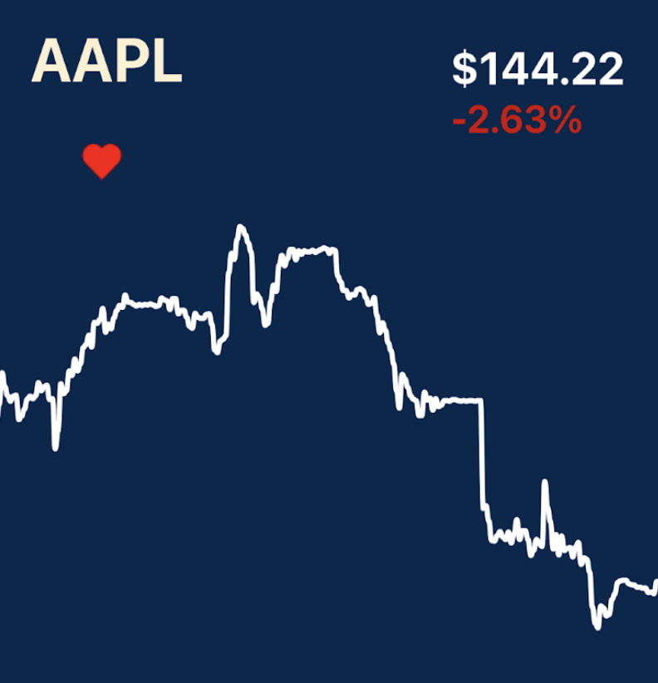
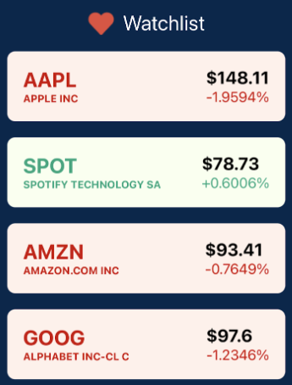
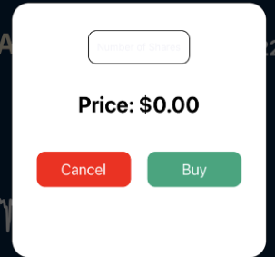
GENERAL FEATURES
🍐 Login/Register
🍐 Stock Data
🍐 Viewing Profiles
🍐 Leaderboard
🍐 Buying/Selling/Liking Stocks

